Slide 1
Institutional Sponsored Project - 21EARW492
Team members :-
Amrut Kurtkoti
Amogh Sutar
Ranjeet Shingade
Anant Maliye
KVSS Prathyush
Ritika Javalagi
Malhar Kulkarni
Prasad Basaragi

Slide 2
Work passed on from our Seniors
ASRS Solidworks design with Mechanical specifications
Add the img of initial Solidworks design which we received from kartik

Slide 3
Work done in ISP 2021-22
Mechanical
Electrical
Software :-
a - Development of Digital Twin using MATLAB
b - Developing Platform for ASRS with TwinCAT based Automation
c - Developing Web - based User Interface (U.I) with MySQL Database
d - OPC-UA server setup for future developments and third party software
development and integration
e - A sample implementation of a complete ASRS automation process with
Conveyor system integration

Slide 4
Mechanical
Add latest Solidworks screenshot

Slide 5
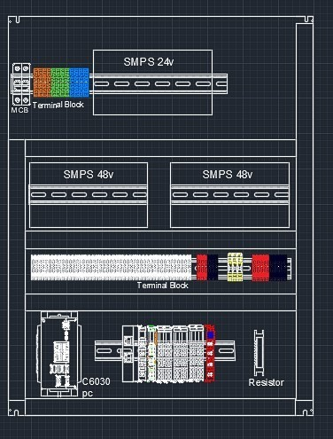
Electrical
AutoCAD panel designing

Slide 6
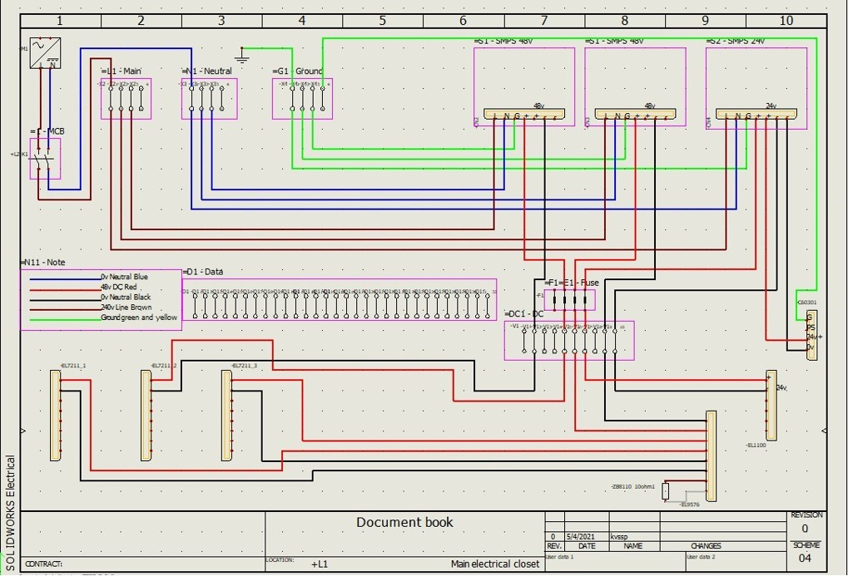
Solidworks Electrical

Slide 7
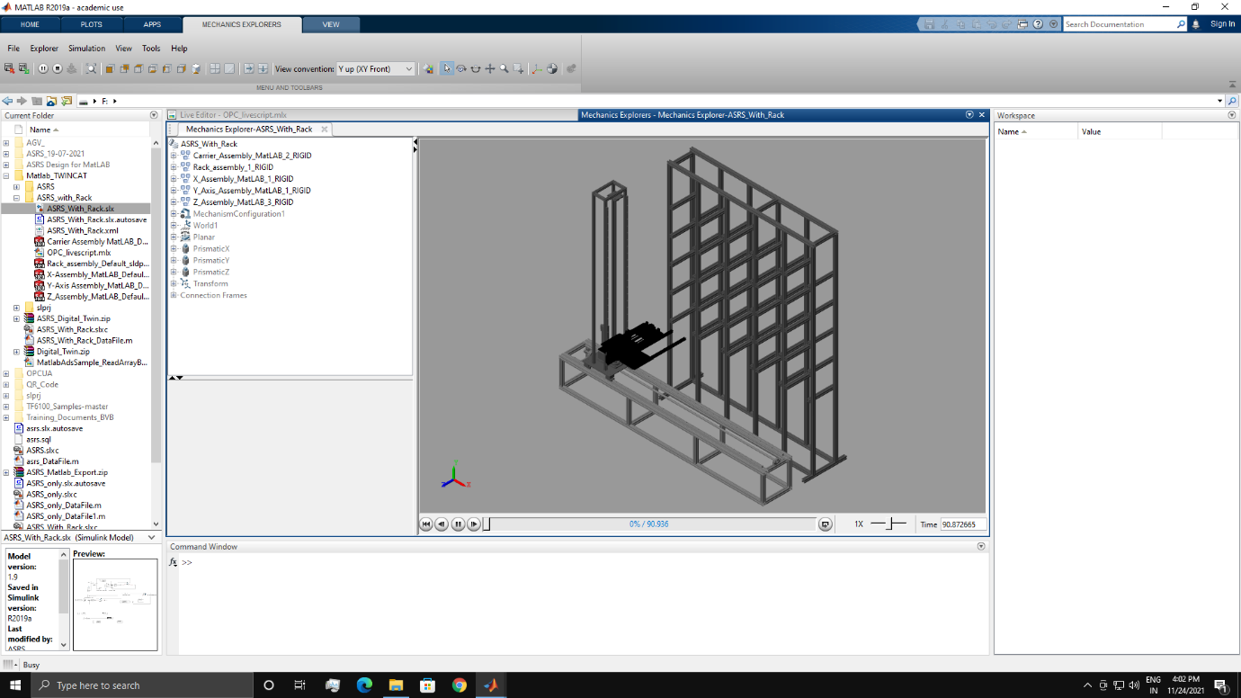
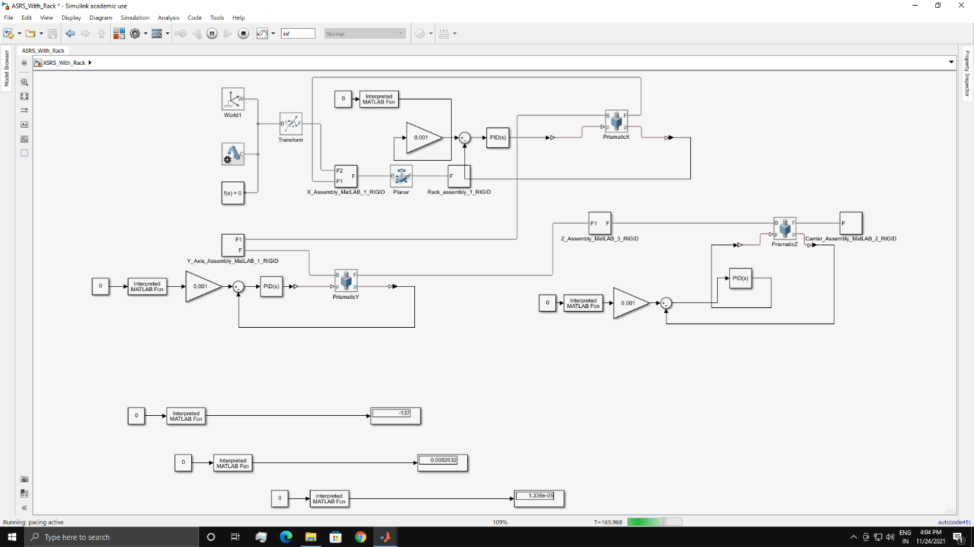
Software
MATLAB - Digital Twin

Slide 8
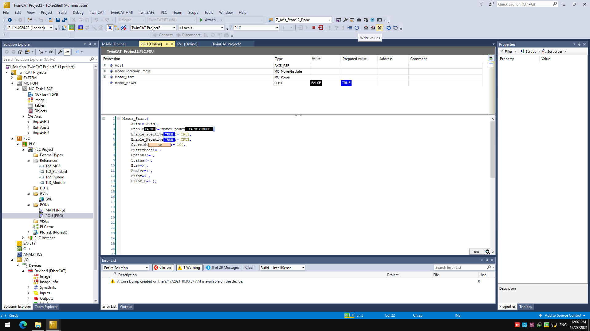
TwinCAT

Slide 9
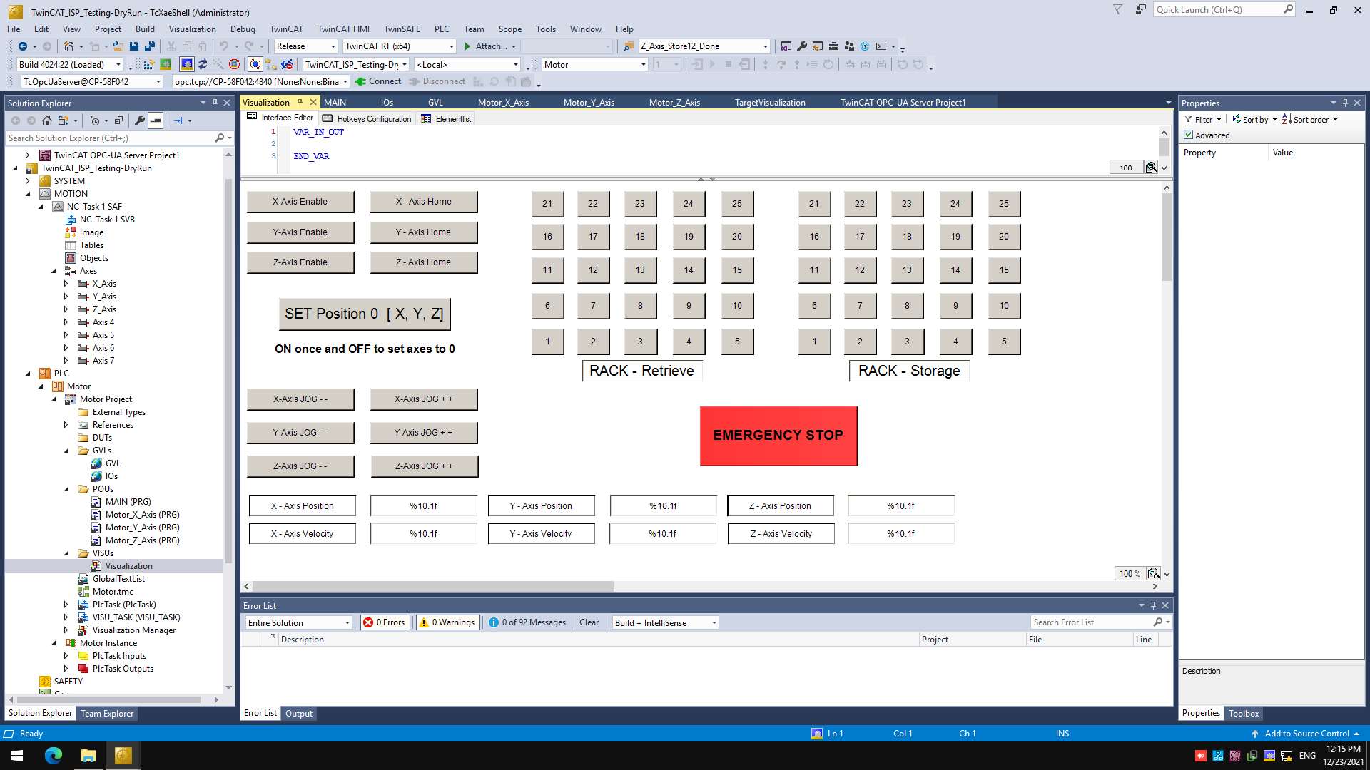
TwinCAT HMI

Slide 10
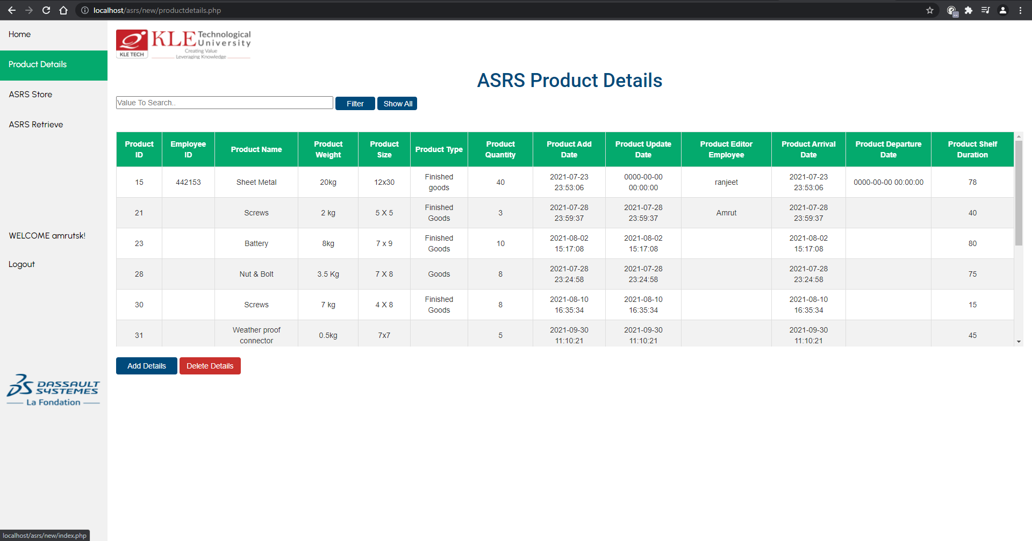
Web - based User Interface (U.I ) with MySQL Database

Slide 11
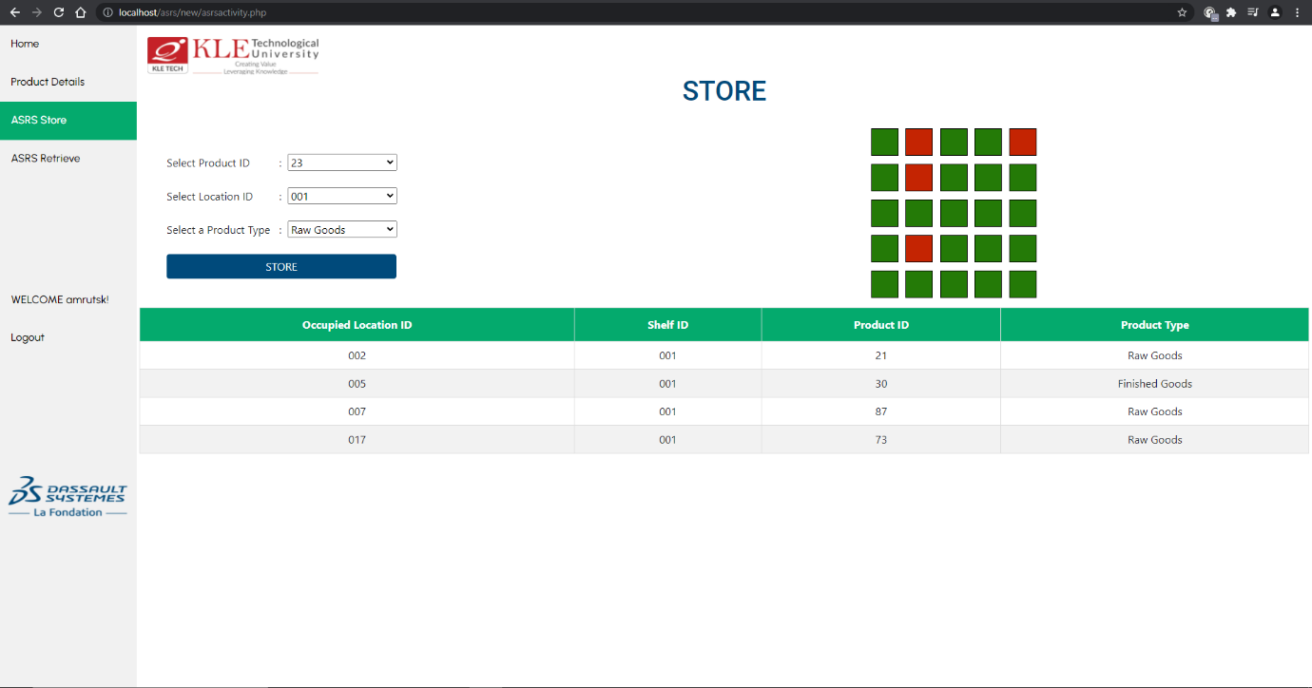

Slide 12
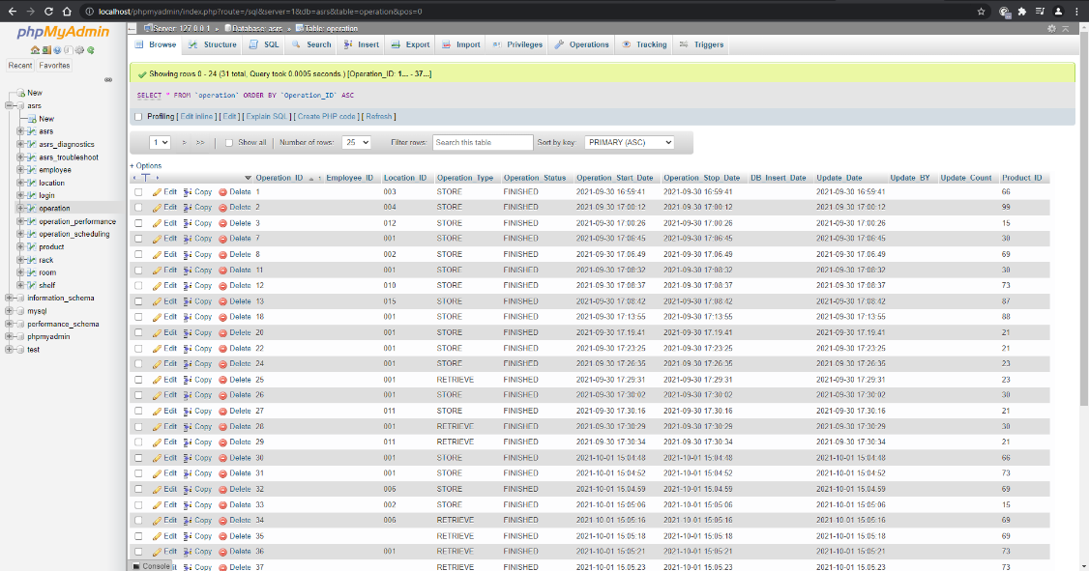
MySQL Database

Slide 13
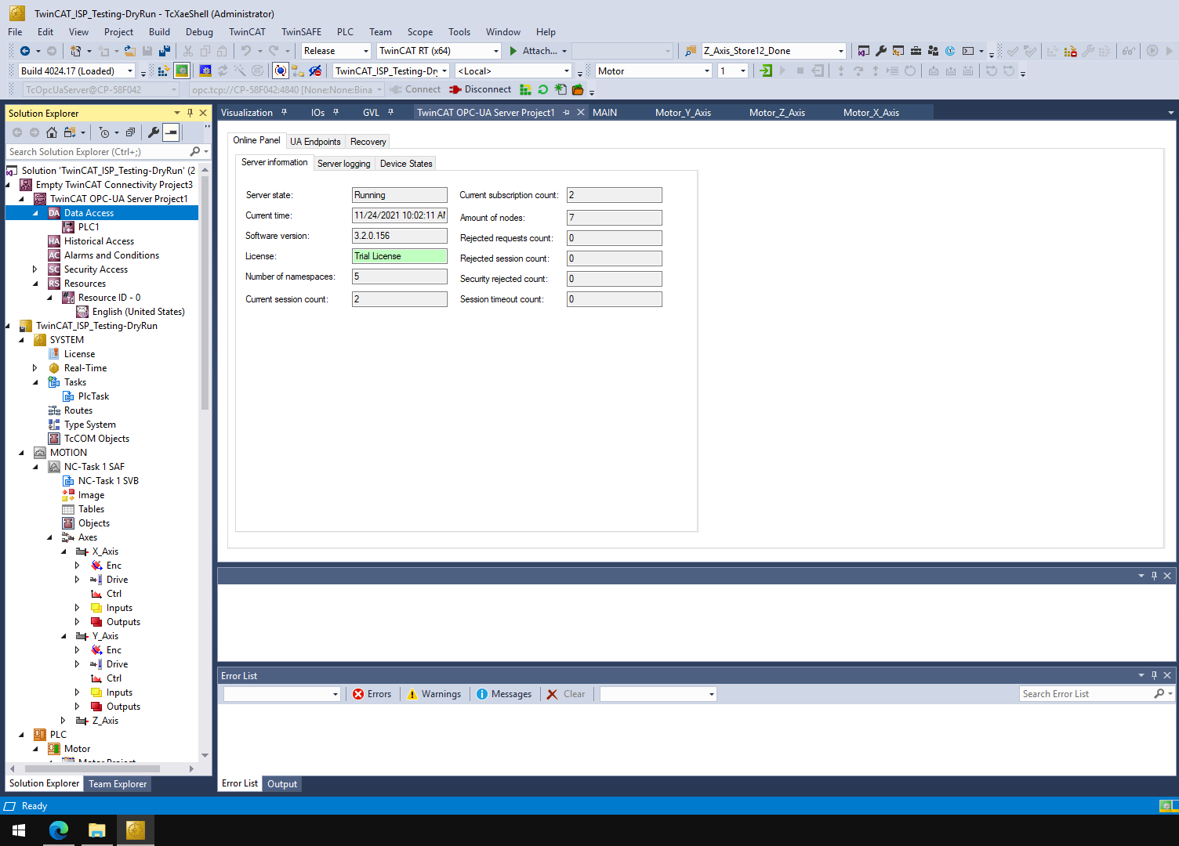
OPC – UA server setup
OPC UA (short for Open Platform Communications United Architecture) is a data exchange standard for industrial communication (machine-to-machine or PC-to-machine communication).

Slide 14
A Sample demo of an automation process

Slide 15
Thank You

